Slide 1
Strange (0-)Days
Robert Hensing
Software Security Engineer (SWI)
Microsoft Corporation

Slide 2
WHOAMI
Robert Hensing (rhensing@microsoft.com)
10 year Microsoft veteran
SWI team member
Prolific, insanely biased blogger
Author of the Stealth chapter in latest Hacking Windows Exposed
Vista x64 user

Slide 3
An Increased Focus on Application Vulnerabilities
The Changing Threat Environment

Slide 4
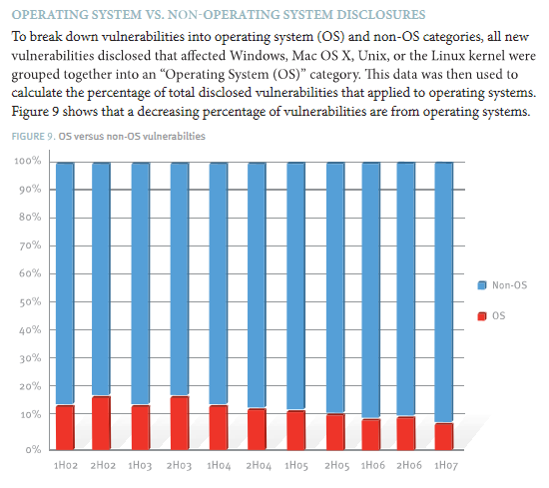
The Changing Threat Environment
Attackers and researchers continue to ‘move up the stack’ when looking for security vulnerabilities focusing on applications that parse binary file formats.
Advanced fuzzers facilitate easier bug finding in these applications.

Slide 5
Moving up the stack? Ya don’t say!
Microsoft has released 32 bulletins affecting Office 2003 SP2 and lower over the product’s life.
  Office 2003 RTM 11/17/2003
    0 bulletins in 2003
    0 bulletins in 2004
    0 bulletins in 2005
    12 bulletins in 2006 ← Umm . . .
    13 bulletins in 2007 ← WTF!?
    7 bulletins so far in 2008 . . . And it’s only March

Slide 6
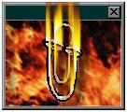

IN SOVIET RUSSIA
CLIPPY FUZZES YOU!!

Slide 7
Targeted Attacks Using Microsoft Office Documents
Case Study

Slide 8
The vulnerability
Un-initialized stack variable vulnerability
  Allocated on stack, not initialized before use
  Prior stack allocations allow attacker to control the contents of memory backing this variable
    Props for creative use of obscure vuln! ☺
This led to a controlled arbitrary 4 byte write to memory.
Attacker chose to overwrite a return address on the stack.
Since it’s not an overrun, it bypasses /GS!

Slide 9
Un-initialized stack variable code execution
Demo

Slide 10
How it went down . . .
Victim(s) received a targeted e-mail with a malformed Excel document attached
When opened the Excel document exploits a vulnerability to cause Excel to run some embedded shellcode
Shellcode extracts an embedded XOR’d well formed XLS file and EXE
  Opens well-formed XLS in Excel
  Executes the extracted EXE which then installs a backdoor as a service (no stealth!?)

Slide 11
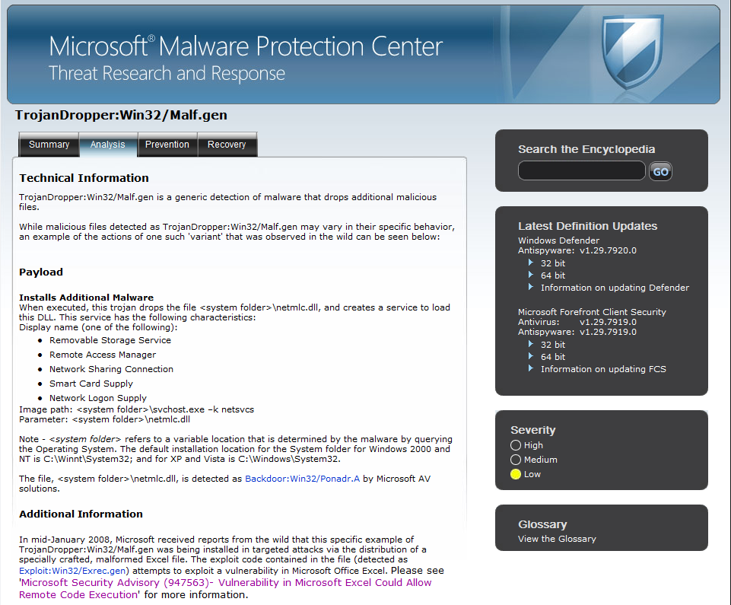
The Payload . . .

Slide 12
Our response . . .
Advisory 947563 was released 1/15/2008 when Microsoft became aware of a 0-day vulnerability in Excel being used in limited targeted attacks.
Some (slightly) good news this time!
  Office 2003 SP3
    RTM 9/18/2007 – Not Affected
  Office 2007 SP0 & SP1
    RTM 1/27/2007 - Not affected
  MOICE

Slide 13
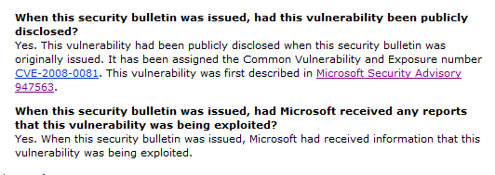
The Security Bulletin
MS08-014 – March 2008
  Addressed 7 vulnerabilities
  The CVE-2008-0081 FAQ Section has some interesting information . . .

Slide 14
Spear phishing for fun and profit . . . .
Demo – Windows XPSP2 + Office 2003 SP2

Slide 15
Observations on XP
Malicious XLS drops an EXE to %TEMP%
The EXE creates a ‘.tmp’ file in users temp folder and executes it.
The malware creates a DLL in system32 and creates a service (HKLM keys)
The binaries are injected into SYSTEM processes like winlogon.exe
Requires regular user rights
Requires regular user rights
Requires admin rights
Requires admin rights

Slide 16
You’re about to get 0wn3d, Cancel or Allow?
Windows Vista + Office 2003 SP2

Slide 17
Observations on Vista
Malicious XLS drops an EXE to %TEMP%
The EXE creates a ‘.tmp’ file in users temp folder and executes it.
The malware creates a DLL in system32 and creates a service (HKLM keys)
The binaries are injected into SYSTEM processes like winlogon.exe
Requires regular user rights
Requires regular user rights
Requires admin rights
Requires admin rights

Slide 18
Reducing the Risk with Windows
Mitigation Strategies

Slide 19
Windows XP - Mitigations
Standard User Accounts
  Greatly limits options for maintaining presence and achieving stealth.
  True security boundary
Use Software Restriction Policies to drop the rights of high-risk applications
  DropMyRights.exe
    http://msdn2.microsoft.com/en-us/library/ms972827.aspx
  Mentioned only for completeness – don’t do this.

Slide 20
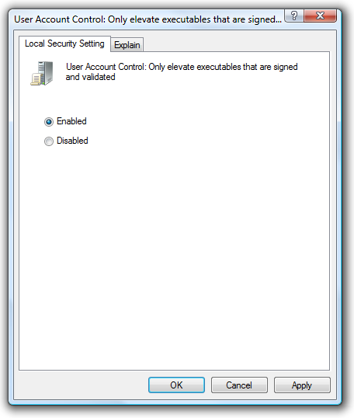
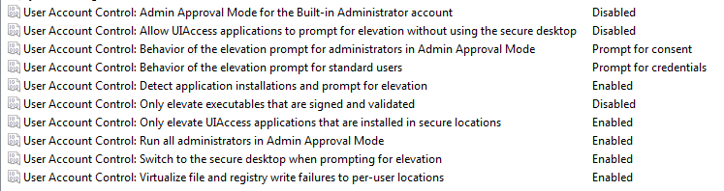
Windows Vista - Mitigations
Use Vista with UAC and leave it on!
  Default UAC is like the ‘Breakfast Blend’
    Good compromise between security and usability
Consider switching to a Dark Roast
  Stronger blend for users with a taste for security

Slide 21
Reducing the Risk with Microsoft Office
Mitigation Strategies

Slide 22
Binary Office File Format vs. Open XML format
A tale of two formats

Slide 23
Office 2003 (and lower) Binary Format
OLE Structured Storage outer format
File system within a file!
Complex file format
complete with
  FAT Table
  Sectors
  Streams (like files)
Another application
specific inner format
within a stream!
STRM1 | STRM2
STRM3 | STRM4
Header

Slide 24
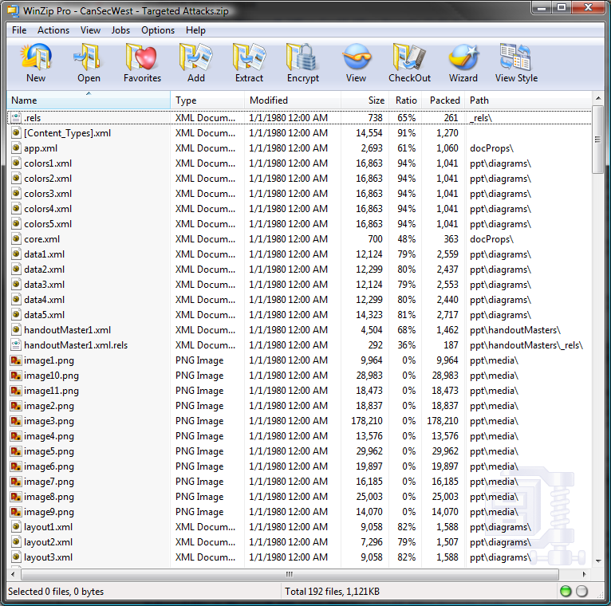
Office 2007 Open XML File Format
Safety was a design goal from the beginning
  Designed under the SDL
ZIP file container with ‘XML parts’
  Also non-XML parts (typically binary data like embedded images or OLE objects)
Non-XML parts can be disabled by policy
Rename to .zip and open with zip file viewer!

Slide 25
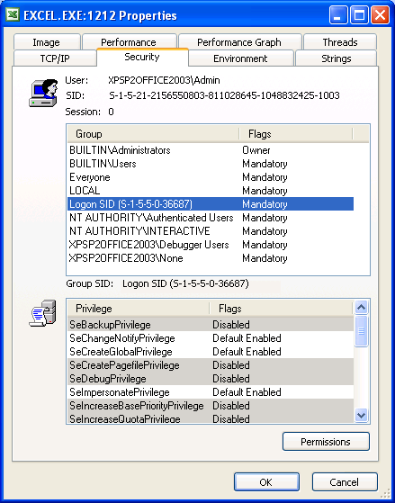
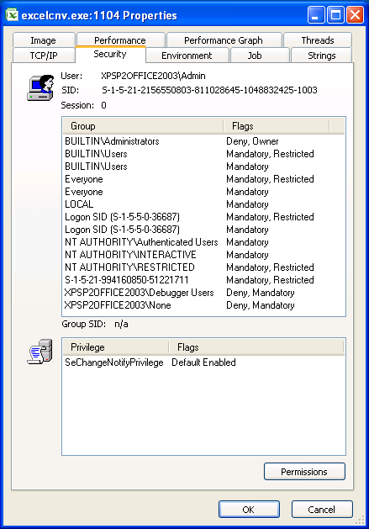
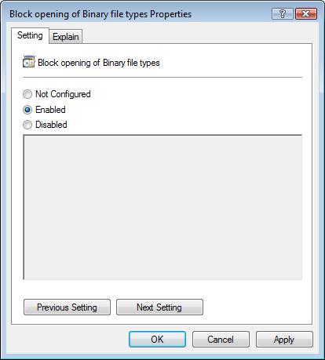
Office - Mitigations
File Block
  Available in Office 2003 (May) & Office 2007
  Prevent Excel, PowerPoint, Word from opening specific file formats (i.e. old binary formats)
Microsoft Office Isolated Conversion Environment
  Converts binary Office docs to the new XML format in a process using a restricted token on a separate desktop!
  Converted document opens in the Office 2003 app using the 2007 File Format Converters
  Should be used with File Block to enforce a safer document opening policy.

Slide 26
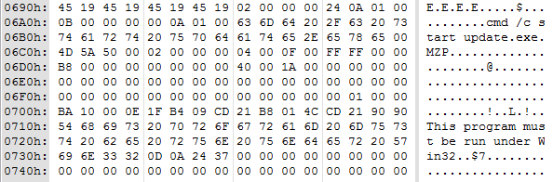
Examining last year’s file . . .
Requires a hex editor + expert knowledge
  Interesting strings in a stream near the beginning of the malicious files!
What could possibly go wrong?

Slide 27
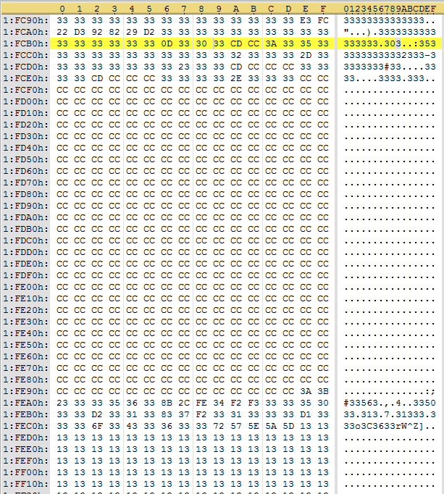
Examining this year’s file . . .
Still requires a hex editor + slightly more expert knowledge
  This year’s malware is much improved, now with XOR encoding!

Slide 28
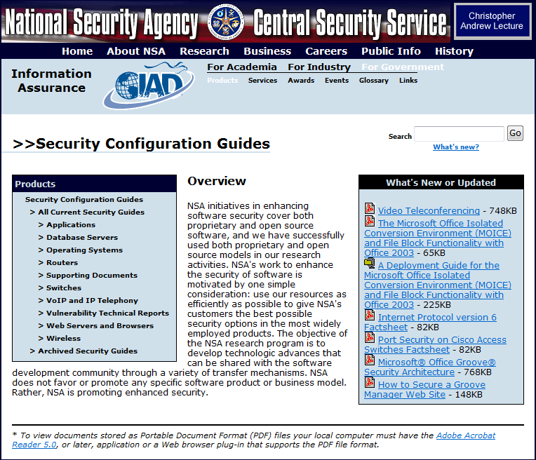
MOICE – Kid Tested, NSA Approved

Slide 29
Better Together
File Block
MOICE
Standard User / UAC
UAC “Dark Roast”

Slide 30
0-Day Fail
Demo – Excel 0-day vs. MOICE

Slide 31
Where do we go from here?
Soooo . . . that’s it?!

Slide 32
Be On The Lookout For . . .
Increasingly sophisticated social engineering attacks involving attachments!
  Unexpected documents delivered via spoofed emails
Suspicious application ‘crashes’
  Always look for ‘Office Watson’ when Office crashes
    Did you see it in my demonstration?
  Check for an audit trail
    Even Log data (or lack thereof)
  When investigating suspicious Office documents – always grab them from the original e-mail (save the e-mail message as a .MSG file via File->Save as)

Slide 33
Advice
Keep up to date on security updates!
  This applies to non-Microsoft applications as well. ☺
Reduce your risk (mitigation strategies)
  Educate employees about targeted attacks
  Use Windows with standard user accounts
Office 2003 & 2007
  If on Office 2003 - Deploy 2003 SP3 immediately
  Read the Office Security Guide
  Evaluate and Deploy MOICE + File Block
Corporate Policy
  Require S/MIME signed emails?
  Deploy SenderID to reject spoofed emails at the edge?

Slide 34
Give us your 0-day
0-day is the spice of life!
Please e-mail all 0-day to:
  secure@microsoft.com
  Cc: rhensing@microsoft.com
  ☺

Slide 35
EOF

Slide 36
Appendix

Slide 37
Links
  Microsoft Office Isolated Conversion Environment (MOICE)
  http://support.microsoft.com/kb/935865
  Plan Block File Format Settings in Office 2007
  http://technet2.microsoft.com/Office/en-us/library/fe3f431c-8d7a-45c8-954f-1268f3b533161033.mspx
  Structured Storage File Format Specification
  http://aafassociation.org/html/specs/aafcontainerspec-v1.0.1.pdf
  Office 2007 Open XML File Format
  http://msdn2.microsoft.com/en-us/library/aa338205.asp

Slide 38
Links
  NSA Security Configuration Guides
  http://www.nsa.gov/snac/
  Spear Phishing
  http://www.microsoft.com/athome/security/email/spear_phishing.mspx
  Security Intelligence Report (Jan – June 2007)
  http://www.microsoft.com/security/portal/SIR.aspx
  Results of Implementing the SDL
  http://msdn2.microsoft.com/en-us/library/ms995349.aspx#sdl2_topic4
  David LeBlanc’s Blog
  http://blogs.msdn.com/david_leblanc/default.aspx

Slide 39
Links
  Restricted Tokens
  http://msdn2.microsoft.com/en-us/library/aa379316(VS.85).aspx
  Practical Sandboxing Part 1
  http://blogs.msdn.com/david_leblanc/archive/2007/07/27/practical-windows-sandboxing-part-1.aspx
  Practical Sandboxing Part 2
  http://blogs.msdn.com/david_leblanc/archive/2007/07/30/practical-windows-sandboxing-part-2.aspx
  Practical Sandboxing Part 3
  http://blogs.msdn.com/david_leblanc/archive/2007/07/31/practical-windows-sandboxing-part-3.aspx

Slide 40

© 2007 Microsoft Corporation. All rights reserved. Microsoft, Windows, Windows Vista and other product names are or may be registered trademarks and/or trademarks in the U.S. and/or other countries.
The information herein is for informational purposes only and represents the current view of Microsoft Corporation as of the date of this presentation. Because Microsoft must respond to changing market conditions, it should not be interpreted to be a commitment on the part of Microsoft, and Microsoft cannot guarantee the accuracy of any information provided after the date of this presentation.
MICROSOFT MAKES NO WARRANTIES, EXPRESS, IMPLIED OR STATUTORY, AS TO THE INFORMATION IN THIS PRESENTATION.

